Slide 1
Morphological Aspects of Computer-Driven Elicitation of Knowledge about Any Language
Sergei Nirenburg and Marjorie McShane
University of Maryland Baltimore County

Slide 2
How to create NLP resources for a new language?
By hand
By parameterizing:
Translation-based methods (e.g., Probst, Levin et al.)
Easy for informants
Coverage a problem
ML (quick ramp-up competitions; parallel corpora; learning morphology)
Quality a problem
Rules are not human interpretable
Interactive knowledge elicitation system
Lots of choices which determine ultimate form, coverage, etc., of knowledge
This talk focuses on some of the choices and their implications in the realm of morphology

Slide 3
Boas Knowledge elicitation system
Supports computational field linguistics
Extracts knowledge about any language from a non-expert informant
No knowledge engineer involved
English is assumed as the language of HCI
Mixed-initiative knowledge elicitation strategy
System is supplied with cross-linguistically motivated inventory of parameters and values
The “signature” of a language is how it realizes linguistic parameters

Slide 4
Examples of parameters and values
Case: nominative, accusative, dative…
Number: singular, plural, dual, paucal…
Tense: past, present, future…
Aspect: progressive, simple…
Grammatical role: subject, direct object…
Agreement: subject-verb, noun-adjective…
Open-class lexical meanings: word, phrase, morpheme…
Closed-class lexical meanings: word, phrase, morpheme, feature…
…

Slide 5
Some examples of phenomena we must treat
From:
McShane, Marjorie and Sergei Nirenburg. 2004. Parameterizing the Space of Lexical and Grammatical Meaning Across Languages.
Machine Translation. 18(2) : 129-165.

Slide 7
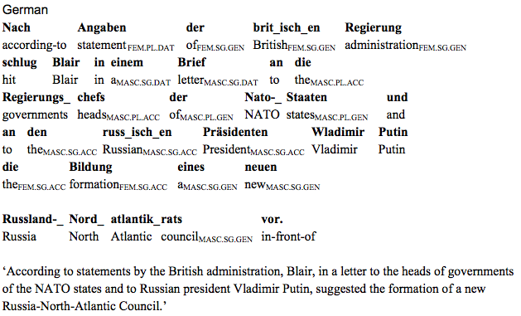

Slide 9
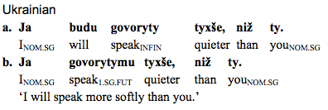

Slide 10
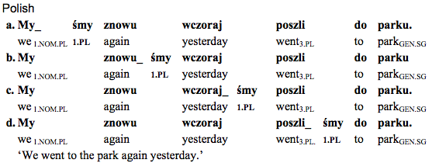

Slide 14
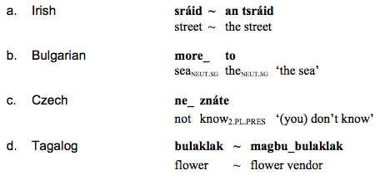

Slide 15
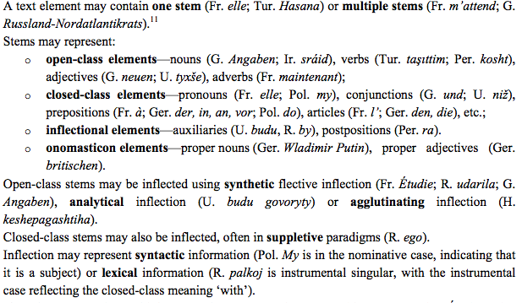

Slide 17
How to get an inventory of parameters and values?
Boas uses a series of KE screens like this one:

Slide 18
Choices related to morphology
Informant: novice or expert?
For inflectional morphology: paradigms or not?
How to define a paradigm for purposes of ML?
How might an informant help to learn inflectional morphology?
What should a paradigm look like?
How can the system help to create good paradigms?
Are analytical forms part of the paradigm?
Does is matter how many paradigms there are?
How to elicit irregular forms of open-class items?
How to elicit agglutinating morphology?

Slide 19
The informant: a linguistic novice or An expert?
If the informant is an expert the system must:
Initiate the expert into a KE process that is more constrained than that typically used in field linguistics; e.g., must use the expressive means provided in the system and not, say, free prose
Impose a division of linguistic reality into modules supported by processing engines for which the knowledge is being acquired
Emphasize that typical cases are most important; not focus all energies on exceptions (no “teratology”)
Coax the expert into carrying out more manual work than he/she might want to do

Slide 20
If the informant is a novice the system must:
Provide extensive pedagogical materials (if we assume no human linguistic guide accompanying the system)
Assist the informant in creating generalizations and abstractions
Provide redo and refinement capabilities, to the extent possible, with as little work lost as possible (this can get very complex fast: e.g. a person has created inflectional paradigms and realizes he has forgotten a parameter)
Help the informant to find a balance between listing (conceptually easier but more time-consuming) and creating abstractions and related rules (conceptually more difficult but potentially faster)

Slide 21
For Inflectional morphology, Paradigms or not?
The existence of morphological analyzers for flective languages is practically taken as a given in current NLP systems but it is not, in principle, a necessity.
Listing all inflectional forms in the lexicon might be a better (or additional) option if:
Labor is cheap
A language has a lot of irregular forms (e.g., Irish)
The knowledge engineers have difficulty making linguistic abstractions
Another option would be to elicit inventories of affixes and morphotactic rules; however, it would be difficult to develop expressive means that would permit an informant to convey, in a way the program could unambiguously understand, the range of possible inflectional processes that lie outside of strict affixation: stem-internal changes, infixation, etc.

Slide 22
Pros and cons of inflectional paradigms
Pros:
Can learn morphological rules in well-understood ways
Limits listing of forms, saves time
Covers new inputs (e.g., newly coined words)
Cons of paradigms
How to define a paradigm? How many paradigms?
Russian grammars typically state that there are four major nominal declensions but Wade (1992) posits over thirty subclasses and Zalizniak (1967), over 70
Polish grammars tend to avoid the paradigm issue completely for nouns, giving stem-specific endings for each combination of case, number, gender and virility (Bielec 1998; Kaleta 1998)

Slide 23
How to define paradigm for ML?
Will inherent features, like gender or animacy, be available to the learner/analyzer/generator, e.g., through a lexicon?
Will the ML algorithm permit paradigm bunching based on the stem form?
E.g., for the invented example below, would the learner learn that stems in –dyt have a different NomPl ending than stems in –myt?

Slide 24
Our most sophisticated ML engine
Developed by Kemal Oflazer (Oflazer, Nirenburg, McShane 2001)
Sample inflectional paradigms were compiled into a finite state transducer lexicon and combined with a sequence of morphographemic rewrite rules induced using transformation-based learning
The engine generated as well as analyzed
Permitted learning loop elicitation methodology:
Informant provides full inflectional forms for one example of each paradigm
System learns rules
Informant provides more citation forms as examples
System generates what it believes to be correct forms
Informant corrects mistakes; system relearns
There is no incorrect way to provide forms or delineate paradigms using this methodology (though some approaches are more efficient than others)

Slide 25
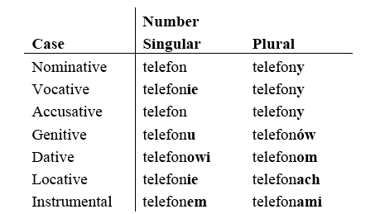
Polish was used as a test case for development of the ML system.
To the left is the primary example of a “bunched” paradigm that ultimately covered 18 word-final consonants and consonant clusters.
Additional provided inflectional forms permitted the learning of many stem-specific variations, including such things as:
b,p,f,w,m,n,s,z,t,d,st,zm take Loc/Voc Sing ending –ie
g,k,ch take Loc/Voc Sing ending –u
Before the Loc/Voc Sing affix, many consonant alternations take place, including and others
Etc!

Slide 26
What if the ML algorithm must be simpler?
The approach just described relied on a toolset that ceased to be available at some point
It also involved a learning-loop methodology that involved generation of forms as well as analysis
As an alternative, one can create a simpler ML system that shifts some more work to the informant; e.g.,
Perhaps all words in every paradigm must inflect exactly the same way
Perhaps the informant will be asked to explicitly specify the stem for each paradigm
Perhaps the informant will be required to indicate stem-affix boundaries (segmentation)

Slide 27
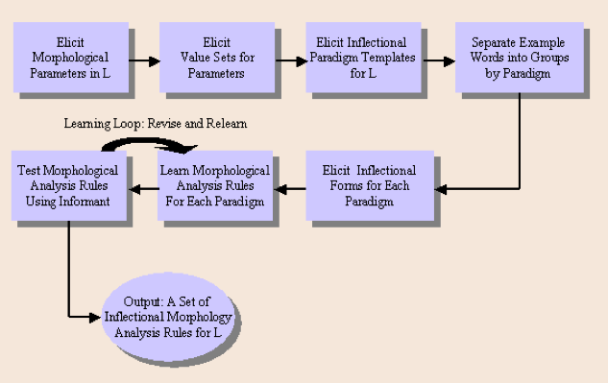

Slide 28
How might an informant help to generate good inflectional rules?
Rules could be shown to the informant, if they are or could be made transparent: e.g., a bad rule for dog > dogs would be “lop off the g and add gs”
The bootstrapping learning loop methodology could be used, as described earlier (generate forms for the user to check)
The informant could be asked for additional information to guide learning: an inventory of affixes, the stem for each paradigm, known stem alternations, whether or not the language has fleeting vowels, whether the language uses infixation, etc.

Slide 29
In one version of the Boas system, a simplified ML engine was used and informants were asked to indicate the stem.

Slide 30
What should a paradigm look like?
The more forms a paradigm has, the more important it is to organize them in a way that is convenient for a given informant; the traditional large tables of reference grammars are not necessarily the most user-friendly
The two following screen shots show a novel layout for a French paradigm
Emphasis on visualization, organization, putting like forms together for ergonomic reasons and, possibly, to support more efficient ML
Recent advances in GUI technologies could revolutionize how we think about grammar description.

Slide 31
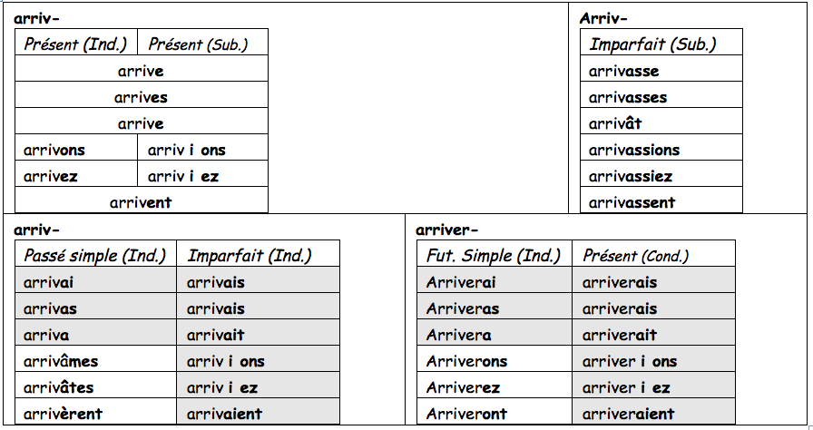
All single-word forms together (see next page for compound forms)
Upper left: mostly merge present indicative and subjunctive; visually underscore difference (addition of “I” using spacing or another means)
Shaded cells in left and right bottom have same endings.

Slide 32
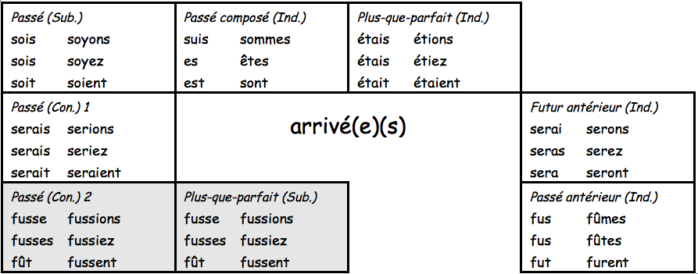
All compound forms have same participial forms of main verb, represented as a hub.
Shaded boxes show that same forms can represent two meanings.
All “ser-” forms in one row; all “fus-” forms in another row.

Slide 33
The paradigm layouts in boas
Two main options (these days GUI support would allow much more)
Simple table with parameters in any order
Hierarchical layout, with parameters in any order and any number of levels of hierarchy

Slide 34
Once the template is created, How can the system help to create good paradigms?
Boas had “fast lane” and “scenic route” for creating paradigms
Fast lane: informant decides how many/which paradigms to create
Scenic route:
Informant translates a pre-compiled word list and indicates any grammatically relevant inherent features
The system posits paradigms based on inherent features and word forms (ends with consonant, ends with vowel, etc.)
Informant decides whether the words in the posited groups inflect similarly; splits or bunches groups accordingly

Slide 35
Scenic route, step 1: Translation and inherent features

Slide 36
Scenic route, Steps 2&3: paradigm guessing, modifying

Slide 37
Are analytical inflectional forms part of the paradigm?
It is conceptually simplest to include these in the paradigm, especially since in some languages synthetic and analytical forms are alternatives: Ukrainian budu pysaty vs. pysatymu
But this complicates the ML algorithm.

Slide 38
The boas solution
Once the paradigm template is established, the informant divides table cells up into those that have single-word, multi-word, or both single- and multi-word realizations
The single-word entities are extracted and dealt with in paradigms in the way described above
Multi-word entities are sent to a different elicitation module where the informant provides an inventory of auxiliaries and their inflectional forms, if applicable, then links them to the correct forms of the main verb

Slide 39
Does it matter how many paradigms there are?
It does if the informant is expected to manipulate them later on: e.g., if he is expected to assign every open-class word to a paradigm explicitly
If explicit assignment is necessary, then it should at least be made semi-automatic

Slide 40
How to elicit Irregular forms of open class items?
Clicking on “paradigm” takes user to a template to fill out.

Slide 41
How to elicit Agglutinating Inflectional morphology?

Slide 42
Combined agglutinating affix elicitation

Slide 43
Where else can inflectional meanings occur? morphology/syntax interface

Slide 44
More morphological realizations: Closed class lexicon

Slide 45
Closed class Lexicon acquisition interface

Slide 46
And still more meanings realized via affixes

Slide 47
What can be exploited in building NLP resources?
Cross-linguistic generalizations: parameters and values, lists of various types, etc.
Technology
Complex control structures (e.g., permitting redo of partial results: “I forgot one parameter in the 40 paradigms I have already developed!”)
Importing available resources for L (e.g., lexicon)
Modifying available resources for some language like L (e.g., build Catalan system from Spanish one)

