Slide 1
Language Models for Machine Translation: Original vs. Translated Texts
Gennadi Lembersky
Noam Ordan
Shuly Wintner
MTML, 2011

Slide 2
Background

Slide 3
Background: Original vs. Translated Texts
LM
Soure Text
Target Text
TM
Wanderer's Night Song Up there all summits are still. In all the tree-tops you will feel but the dew. The birds in the forest stopped talking. Soon, done with walking, you shall rest, too. (~50 translations into Hebrew) | Wandrers Nachtlied Über allen Gipfeln ist Ruh, in allen Wipfeln spürest du kaum einen Hauch; die Vögelein schweigen im Walde, warte nur, balde ruhest du auch! (26 tokens)

Slide 4
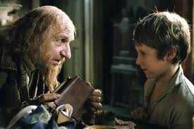
Background: Is sex/translation dirty?
LM
Soure Text
Target Text
TM

Slide 5
Background: Original vs. Translated Texts
Given this simplified model:
Two points are made with regard to the “intermediate component” (TM and LM):
TM is blind to direction (but see Kurokawa et al., 2009)
LMs are based on originally written texts.
LM
Source Text
Target Text
TM

Slide 6
Background: Original vs. Translated Texts
LMs are based on originally written texts for two possible reasons:
They are more readily available;
Perhaps the question of whether they are translated or not is considered irrelevant for LM.

Slide 7
Background: Original vs. Translated Texts
Translated texts are ontologically different from non-translated texts ; they generally exhibit
Simplification of the message, the grammar or both (Al-Shabab, 1996, Laviosa, 1998) ;
Explicitation, the tendency to spell out implicit utterances that occur in the source text (Blum-Kulka, 1986).

Slide 8
Background: Original vs. Translated Texts
Translated texts can be distinguished from non-translated texts with high accuracy (87% and more)
For Italian (Baroni & Bernardini, 2006)
For Spanish (Iliseiet al., 2010);
For English (Koppel & Ordan, forthcoming)

Slide 9
Hypotheses

Slide 10
Our Hypotheses
We investigate the following three hypotheses:
Translated texts differ from original texts
Texts translated from one language differ from texts translated from other languages
LMs compiled from translated texts are better for MT than LMs compiled from original texts

Slide 11
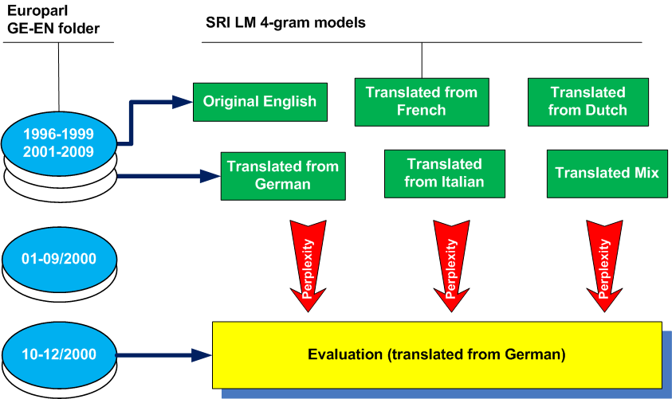
Testing Hypothesis 1+2

Slide 12
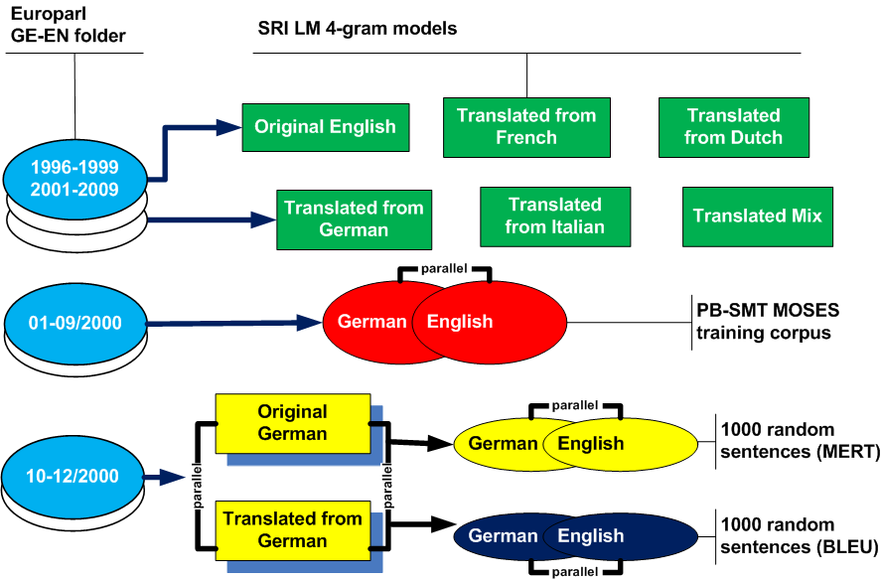
Testing Hypothesis 3

Slide 13
Identifying the Source Language
For the most part, we rely on the LANGUAGE attribute of the SPEAKER tag
<SPEAKER LANGUAGE=“DE” ID=“…”/>
BUT: it is rarely used with British MEPs
To identify original English speakers we use ID attribute, which we match against the list of British members of the European parliament

Slide 14
Europarl Experiments

Slide 15
Resources
4 European language pairs taken from Europarl
German – English
Dutch – English
French – English
Italian – English

Slide 16
Language Models Stats
German - English
Len | Tokens | Sent’s | Orig. Lang.
28.12 | 2,325,261 | 82,700 | Mix
25.52 | 2,324,745 | 91,100 | O-EN
26.43 | 2,322,973 | 87,900 | T-DE
24.72 | 2,323,646 | 94,000 | T-NL
29.98 | 2,325,183 | 77,550 | T-FR
35.68 | 2,325,996 | 65,199 | T-IT
Dutch - English
Len | Tokens | Sent’s | Orig. Lang.
27.72 | 2,508,265 | 90,500 | Mix
25.52 | 2,475,652 | 97,000 | O-EN
26.57 | 2,503,354 | 94,200 | T-DE
24.66 | 2,513,769 | 101,950 | T-NL
29.13 | 2,523,055 | 86,600 | T-FR
34.24 | 2,518,196 | 73,541 | T-IT

Slide 17
Language Models Stats
French - English
Len | Tokens | Sent’s | Orig. Lang.
28.07 | 2,546,274 | 90,700 | Mix
25.64 | 2,545,891 | 99,300 | O-EN
26.83 | 2,546,124 | 94,900 | T-DE
24.63 | 2,545,645 | 103,350 | T-NL
29.69 | 2,546,085 | 85,750 | T-FR
35.37 | 2,546,984 | 72,008 | T-IT
Italian - English
Len | Tokens | Sent’s | Orig. Lang.
29.12 | 2,534,793 | 87,040 | Mix
27.11 | 2,534,892 | 93,520 | O-EN
27.99 | 2,534,867 | 90,550 | T-DE
26.18 | 2,535,053 | 96,850 | T-NL
30.57 | 2,534,930 | 82,930 | T-FR
36.60 | 2,535,225 | 69,270 | T-IT

Slide 18
SMT Training Data
Len | Tokens | Sent’s | Side | Lang’s
26.26 | 2,439,370 | 92,901 | DE | DE-EN
28.01 | 2,602,376 | 92,901 | EN
27.44 | 2,327,601 | 84,811 | NL | NL-EN
27.16 | 2,303,846 | 84,811 | EN
28.02 | 2,610,551 | 93,162 | FR | FR-EN
30.80 | 2,869,328 | 93,162 | EN
29.62 | 2,531,925 | 85,485 | IT | IT-EN
29.45 | 2,517,128 | 85,485 | EN

Slide 19
Reference Sets
Len | Tokens | Sent’s | Side | Lang’s
24.25 | 161,889 | 6,675 | DE | DE-EN
26.81 | 178,984 | 6,675 | EN
24.88 | 114,272 | 4,593 | NL | NL-EN
22.88 | 105,083 | 4,593 | EN
30.63 | 260,198 | 8,494 | FR | FR-EN
31.97 | 271,536 | 8,494 | EN
36.25 | 82,261 | 2,269 | IT | IT-EN
34.49 | 78,258 | 2,269 | EN

Slide 20
Hypotheses 1+2 Results
German - English
PP | Unigrams | Orig. Lang.
83.45 | 32,238 | Mix
96.50 | 31,204 | O-EN
77.77 | 27,940 | T-DE
89.17 | 28,074 | T-NL
92.71 | 29,405 | T-FR
95.14 | 28,586 | T-IT
Dutch - English
PP | Unigrams | Orig. Lang.
87.37 | 33,050 | Mix
100.75 | 32,064 | O-EN
90.35 | 28,766 | T-DE
78.25 | 29,178 | T-NL
96.38 | 30,502 | T-FR
99.26 | 29,386 | T-IT

Slide 21
Hypotheses 1+2 Results
French - English
PP | Unigrams | Orig. Lang.
87.13 | 33,444 | Mix
105.93 | 32,576 | O-EN
96.83 | 28,935 | T-DE
100.18 | 29,221 | T-NL
82.23 | 30,609 | T-FR
91.15 | 29,633 | T-IT
Italian - English
PP | Unigrams | Orig. Lang.
90.71 | 33,353 | Mix
107.45 | 32,546 | O-EN
100.46 | 28,835 | T-DE
105.07 | 29,130 | T-NL
92.18 | 30,460 | T-FR
80.57 | 29,466 | T-IT

Slide 22
Hypothesis 1+2 Results
Corpora statistics and LM perplexity results support the hypotheses:
translated and original texts are different
texts translated from one language are different from texts translated from another language
For every source language, L:
LM trained on texts translated from L has the lowest (the best) perplexity
The MIX LMs are second-best and the LMs trained on texts translated from related languages (German<->Dutch; French<->Italian) are next
The LMs trained on original English texts are the worst

Slide 23
Hypotheses 3 (MT) Results
German - English
BLEU | Orig. Lang
21.95 | Mix
21.35 | O-EN
22.42 | T-DE
21.59 | T-NL
21.47 | T-FR
21.79 | T-IT
Dutch - English
BLEU | Orig. Lang
25.17 | Mix
24.46 | O-EN
25.12 | T-DE
25.73 | T-NL
24.79 | T-FR
24.93 | T-IT
French - English
BLEU | Orig. Lang
25.43 | Mix
24.85 | O-EN
25.03 | T-DE
25.17 | T-NL
25.91 | T-FR
25.44 | T-IT
Italian - English
BLEU | Orig. Lang
26.79 | Mix
25.69 | O-EN
25.86 | T-DE
25.77 | T-NL
26.56 | T-FR
27.28 | T-IT

Slide 24
Hypotheses 3 (MT) Results / 2
The results support the hypothesis:
For every source language L, the MT system that uses LM trained on text translated from L has the best translations.
Systems that use O-EN LMs got the lowest BLEU scores.
Statistical significance (bootstrap resampling):
The best-performing system is statistically better than all other systems (p < 0.05)
The best-performing system is statistically better than O-EN system (p < 0.01)
The MIX systems are statistically better than O-EN systems (p < 0.01)

Slide 25
Hebrew-English Experiments

Slide 26
Hebrew-English MT System
MOSES PB-SMT
Factored Translation Model (surface | lemma) trained on ~ 65,000 parallel sentences
Fully segmented source (Hebrew)
Morphological analyzer (from “MILA” knowledge center) and Roy Bar-Haim’s disambiguator
Lemma-based alignment + “trgtosrc alignment”
Performance:
~ 23 BLEU on 1000 sentences with 1 ref. translations
~ 32 BLEU on 300 sentences with 4 ref. translations
Demo: http://mt.cs.haifa.ac.il/mtdemo/translate.php

Slide 27
Language Model Resources
Two English Corpora for the language models
Original English corpus (O-EN) – “International Herald Tribune” articles collected over a period of 7 months (January to July 2009)
Translated from Hebrew (T-HE) – Israeli newspaper “HaAretz” published in Hebrew collected over the same period of time
Each corpus comprises 4 topics: news, business, opinion and arts
Both corpora have approximately the same number of tokens in each topic

Slide 28
Language Models Resources
Hebrew - English
Len | Tokens | Sent’s | Orig. Lang.
26.3 | 3,561,559 | 135,228 | O-EN
24.2 | 3,561,556 | 147,227 | T-HE

Slide 29
Parallel Resources
SMT Training Model
Hebrew-English parallel corpus (Tsvetkov and Wintner, 2010)
Genres: news, literature and subtitles
Original Hebrew (54%)
Original English (46%) – mostly subtitles
Reference Set
Translated from Hebrew to English
Literature (88.6%) and news (11.4%)

Slide 30
Parallel Resources
Len | Tokens | Sent’s | Side | Lang’s
SMT Training Data
7.6 | 726,512 | 95,912 | HE | HE-EN
8.9 | 856,830 | 95,912 | EN
Reference Set
13.5 | 102,085 | 7,546 | HE | HE-EN
16.7 | 126,183 | 7,546 | EN

Slide 31
Hypothesis 1 Results
Hebrew - English
PP | Unigrams | Orig. Lang.
282.75 | 74,305 | O-EN
226.02 | 61,729 | T-HE
Problem: What if the different perplexity results are due to the contents bias between T-HE corpus and the reference sets
We conducted more experiments in which we gradually abstract away from the specific contents

Slide 32
Abstraction Experiments
4 abstraction levels:
1 – we remove all punctuation
2 – we replace named entities with a “NE” token
We use Stanford Named Entity Recognizer
We train 5-gram LMs
3 – we replace all nouns with a their POS tag
We use Stanford POS Tagger
We train 5-gram LMs
4 – we replace all tokens with their POS tags
We train 8-gram LM

Slide 33
Abstraction Experiments
PP diff. | T-HE | O-EN | Abstraction
 | PP | PP
19.2% | 358.11 | 442.95 | No Punctuation
17.3% | 289.71 | 350.3 | NE Abstraction
12.4% | 81.72 | 93.31 | Noun Abstraction
6.2% | 10.76 | 11.47 | POS Abstraction
T-HE fits the reference consistently better than O-EN

Slide 34
Hypothesis 3 (MT) Results
Hebrew - English
BLEU | Orig. Lang
11.98 | O-EN
12.57 | T-HE
T-HE system produces slightly better results
The gain is statistically significant (p = 0.012 < 0.05)

Slide 35
Discussion

Slide 36
Discussion
The results consistently support our hypotheses:
Translated texts differ from original texts
Texts translated from one language differ from texts translated from other languages
LMs compiled from translated texts are better for MT than LMs compiled from original texts

Slide 37
Discussion
Practical Outcome:
Use LMs trained on texts translated from a source language
If not available, use the mixture of translated texts
The texts translated from languages closely-related to the source language are for most part better than other translated texts

Slide 38
Discussion
Why did it work? Two hypotheses:
Since translations simplify the originals, error potential gets smaller and LMs better predict translated language;
Recurrent multiword expressions in the SL converge to a set of high-quality translations in the TL.

Slide 39
Discussion
When machine translation meets translation studies,
MT Results improve;
Pending hypotheses in translation studies are tested experimentally in a more rigorous way.
We call for further cooperation.

Slide 40
Thank You!

